Slide 1
MS&E 228: Modern Non-Linear Prediction
Vasilis Syrgkanis
MS&E, Stanford

Slide 2
Causal Inference with Experiments
Prediction with Linear Models
Prediction with High-Dim Linear Models
Inference on Causal and Predictive Effects with High-Dim Linear Models
Potential Outcomes and Conditional Ignorability
Structural Equation Models and Conditional Exogeneity
Directed Acyclic Graphs
Prediction with Non-Linear Models
Inference on Causal Effects with Non-Linear Models
Un-observed Confounding and Instruments
Identification of Causal Effects in Longitudinal Data
Estimation of Heterogeneous Causal Effects
Linear Predictive Models and Statistical Inference
Causal Identification in Observational Data
Non-Linear Predictive Models and Statistical Inference
Topics

Slide 3
Causal Inference with Experiments
Prediction with Linear Models
Prediction with High-Dim Linear Models
Inference on Causal and Predictive Effects with High-Dim Linear Models
Potential Outcomes and Conditional Ignorability
Structural Equation Models and Conditional Exogeneity
Directed Acyclic Graphs
Prediction with Non-Linear Models
Inference on Causal Effects with Non-Linear Models
Un-observed Confounding and Instruments
Identification of Causal Effects in Longitudinal Data
Estimation of Heterogeneous Causal Effects
Linear Predictive Models and Statistical Inference
Causal Identification in Observational Data
Non-Linear Predictive Models and Statistical Inference
Topics

Slide 4
Recap

Slide 5
The Predictive Modelling Pipeline
Data Collection
Estimation
(training)
Validation
(testing)
Guarantee that for the sample size we have the resulting solution will be close to the truth under “inductive bias” assumptions on the truly best predictive model (e.g. sparsity)
Theory
e.g. Fit a lasso, OLS, Ridge, ElasticNet model on half of the data
e.g. Calculate RMSE and R-square on the other half and measure performance
Practice

Slide 6
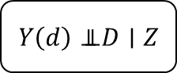
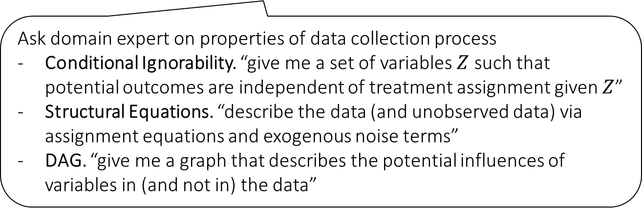



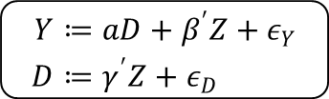
The Causal Modelling Pipeline
Data Collection
Estimation
(training)
Validation
(testing)
Domain Assumption Elicitation
$$Y\left(d\right)⊥⊥ D∣Z$$
Conditional Ignorability
Formal Mathematical Frameworks for Expressing Assumptions
$$\begin{aligned}Y≔&aD+β^{′}Z+ε_{Y} \\ D≔&γ^{′}Z+ε_{D}\end{aligned}$$
Linear SEMs
Theory
$$D$$
DAGs/ASEMs
$$Z$$
$$Y$$
Ask domain expert on properties of data collection process
Conditional Ignorability. “give me a set of variables $Z$ such that potential outcomes are independent of treatment assignment given $Z$”
Structural Equations. “describe the data (and unobserved data) via assignment equations and exogenous noise terms”
DAG. “give me a graph that describes the potential influences of variables in (and not in) the data”
Practice

Slide 7
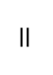
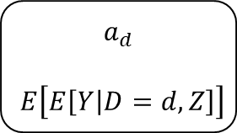



The Causal Modelling Pipeline
Data Collection
Estimation
(training)
Validation
(testing)
Domain Assumption Elicitation
Identification
DAGs/ASEMs
$$a_{d}$$
$$E\left[E\left[Y | D=d,Z\right]\right]$$
Theory
$$D$$
$$=$$
$$Z$$
$$Y$$
Given the domain assumptions, what are the predictive models I need to estimate in the data and how should I combine them to get a causal effect or a mean counterfactual response or a mean response under an intervention
Practice

Slide 8
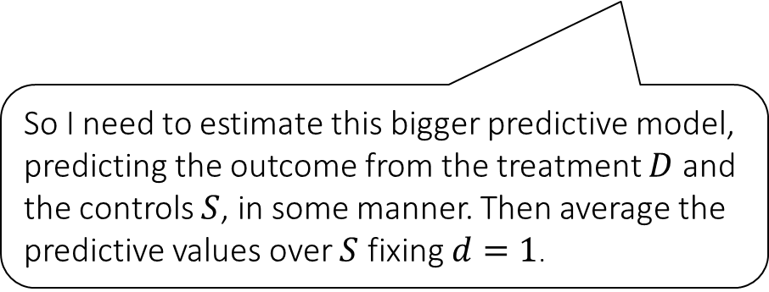
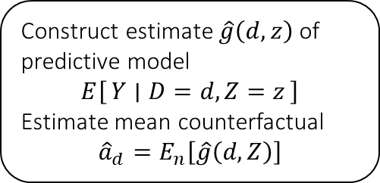
The Causal Modelling Pipeline
Data Collection
Estimation
(training)
Validation
(testing)
Domain Assumption Elicitation
Identification
DAGs/ASEMs
Construct estimate $\hat{g}\left(d,z\right)$ of predictive model
$$E\left[Y ∣ D=d,Z=z\right]$$
Estimate mean counterfactual
$${\hat{a}}_{d}=E_{n}\left[\hat{g}\left(d,Z\right)\right]$$
Theory
$$a_{d}$$
$$E\left[E\left[Y | D=d,Z\right]\right]$$
$$D$$
$$=$$
$$Z$$
$$Y$$
So I need to estimate this bigger predictive model, predicting the outcome from the treatment $D$ and the controls $S$, in some manner. Then average the predictive values over $S$ fixing $d=1$.
Practice

Slide 9
The Causal Modelling Pipeline
Data Collection
Estimation
(training)
Validation
(testing)
Domain Assumption Elicitation
Identification
DAGs/ASEMs
Construct estimate $\hat{g}\left(d,z\right)$ of predictive model
$$E\left[Y ∣ D=d,Z=z\right]$$
Estimate mean counterfactual
$${\hat{a}}_{d}=E_{n}\left[\hat{g}\left(d,Z\right)\right]$$
Theory
$$a_{d}$$
$$E\left[E\left[Y | D=d,Z\right]\right]$$
$$D$$
$$=$$
$$Z$$
$$Y$$
I can do normal cross-validation to evaluate the predictive model that I estimated
Practice

Slide 10
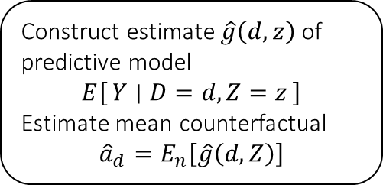
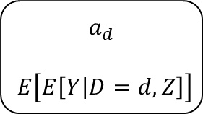
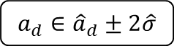
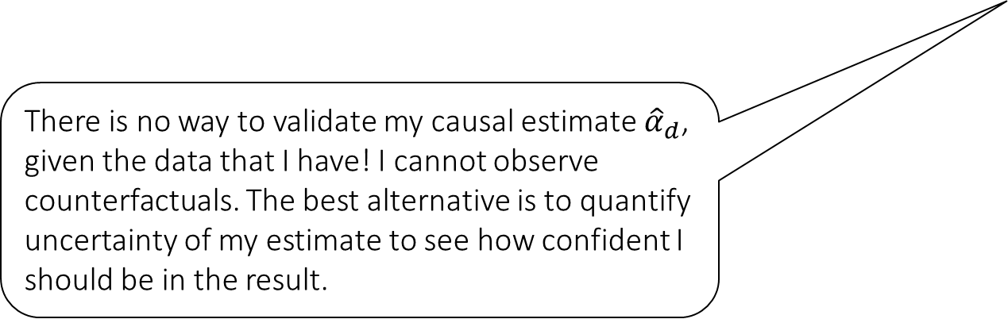
The Causal Modelling Pipeline
Data Collection
Estimation
(training)
Validation
(testing)
Domain Assumption Elicitation
Identification
Inference (Confidence Intervals)
Construct estimate $\hat{g}\left(d,z\right)$ of predictive model
$$E\left[Y ∣ D=d,Z=z\right]$$
Estimate mean counterfactual
$${\hat{a}}_{d}=E_{n}\left[\hat{g}\left(d,Z\right)\right]$$
DAGs/ASEMs
$$a_{d}$$
$$E\left[E\left[Y | D=d,Z\right]\right]$$
Theory
$$D$$
$$=$$
$$a_{d}∈{\hat{a}}_{d}±2\hat{σ}$$
$$Z$$
$$Y$$
There is no way to validate my causal estimate ${\hat{α}}_{d}$, given the data that I have! I cannot observe counterfactuals. The best alternative is to quantify uncertainty of my estimate to see how confident I should be in the result.
Practice

Slide 11
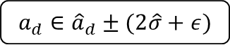
Sneak Peek in Future Lectures
Data Collection
Estimation
(training)
Validation
(testing)
Domain Assumption Elicitation
Identification
Inference (Confidence Intervals)
DAGs/ASEMs
Construct estimate $\hat{g}\left(d,z\right)$ of predictive model
$$E\left[Y ∣ D=d,Z=z\right]$$
Estimate mean counterfactual
$${\hat{a}}_{d}=E_{n}\left[\hat{g}\left(d,Z\right)\right]$$
Theory
$$a_{d}$$
$$E\left[E\left[Y | D=d,Z\right]\right]$$
$$D$$
$$=$$
$$a_{d}∈{\hat{a}}_{d}±2\hat{σ}$$
$$Z$$
$$Y$$
What if my domain assumptions were wrong? How confident should I be of the result? What if there is some remnant unobserved confounder? Can I at least give some bound on the correct answer?
Sensitivity Analysis
Practice
$$a_{d}∈{\hat{a}}_{d}±(2\hat{σ}+ε)$$

Slide 12
Sneak Peek in Future Lectures
Data Collection
Estimation
(training)
Validation
(testing)
Domain Assumption Elicitation
Identification
Inference (Confidence Intervals)
DAGs/ASEMs
Construct estimate $\hat{g}\left(d,z\right)$ of predictive model
$$E\left[Y ∣ D=d,Z=z\right]$$
Estimate mean counterfactual
$${\hat{a}}_{d}=E_{n}\left[\hat{g}\left(d,Z\right)\right]$$
Theory
$$a_{d}$$
$$E\left[E\left[Y | D=d,Z\right]\right]$$
$$D$$
$$=$$
$$a_{d}∈{\hat{a}}_{d}±2\hat{σ}$$
$$Z$$
$$Y$$
What decision or policy should I implement? Should we treat? Who should be treated?
Sensitivity Analysis
Practice
$$a_{d}∈{\hat{a}}_{d}±(2\hat{σ}+ε)$$
Decision
Policy

Slide 13
Practically Relevant Material we might not get to
Data Collection
Estimation
(training)
Validation
(testing)
Domain Assumption Elicitation
Identification
Inference (Confidence Intervals)
DAGs/ASEMs
Construct estimate $\hat{g}\left(d,z\right)$ of predictive model
$$E\left[Y ∣ D=d,Z=z\right]$$
Estimate mean counterfactual
$${\hat{a}}_{d}=E_{n}\left[\hat{g}\left(d,Z\right)\right]$$
Theory
$$a_{d}$$
$$E\left[E\left[Y | D=d,Z\right]\right]$$
$$D$$
$$=$$
$$a_{d}∈{\hat{a}}_{d}±2\hat{σ}$$
$$Z$$
$$Y$$
What RCT/experiment should I run next to validate my finding/policy and collect new data, validate/invalidate domain assumptions
Sensitivity Analysis
Practice
$$a_{d}∈{\hat{a}}_{d}±(2\hat{σ}+ε)$$
Adaptive Experiments
Decision
Policy

Slide 14
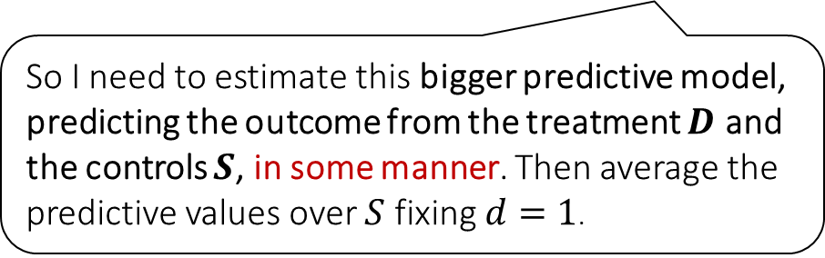
Today
Data Collection
Estimation
(training)
Validation
(testing)
Domain Assumption Elicitation
Identification
Inference (Confidence Intervals)
DAGs/ASEMs
Construct estimate $\hat{g}\left(d,z\right)$ of predictive model
$$E\left[Y ∣ D=d,Z=z\right]$$
Estimate mean counterfactual
$${\hat{a}}_{d}=E_{n}\left[\hat{g}\left(d,Z\right)\right]$$
Theory
$$a_{d}$$
$$E\left[E\left[Y | D=d,Z\right]\right]$$
$$D$$
$$=$$
$$a_{d}∈{\hat{a}}_{d}±2\hat{σ}$$
$$Z$$
$$Y$$
So I need to estimate this bigger predictive model, predicting the outcome from the treatment $D$ and the controls $S$, in some manner. Then average the predictive values over $S$ fixing $d=1$.
Sensitivity Analysis
Practice
$$a_{d}∈{\hat{a}}_{d}±(2\hat{σ}+ε)$$
Adaptive Experiments
Decision
Policy

Slide 15
Goals for Today
How do we estimate predictive models without linearity assumptions
Overview of major mainstream machine learning methods
Random Forests, Gradient Boosted Forests, Neural Networks
Some theoretical guarantees and justification (similar to lasso)
How to combine models (stacking)
How to automate the process (automl)
Next lecture:
Using ML as black-box feature engineering

Slide 16
Modern Non-Linear Predictive Models

Slide 17
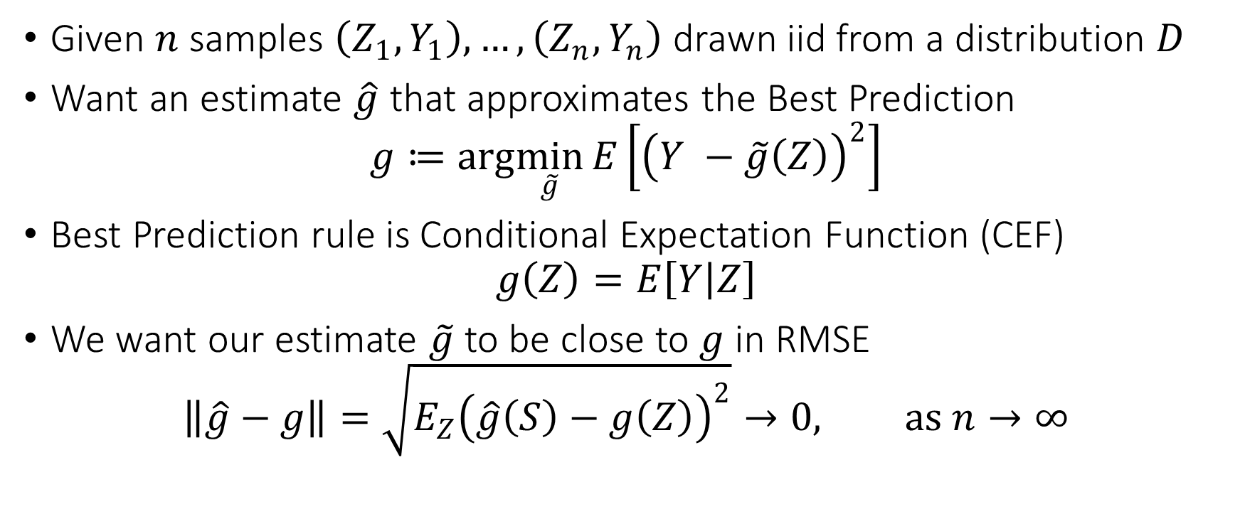
Problem Statement
Given $n$ samples $\left(Z_{1},Y_{1}\right),…,\left(Z_{n},Y_{n}\right)$ drawn iid from a distribution $D$
Want an estimate $\hat{g}$ that approximates the Best Prediction
$$g≔arg\min_{\tilde{g}}{E\left[{\left(Y −\tilde{g}\left(Z\right)\right)}^{2}\right]}$$
Best Prediction rule is Conditional Expectation Function (CEF)
$$g\left(Z\right)=E\left[Y | Z\right]$$
We want our estimate $\tilde{g}$ to be close to $g$ in RMSE
$$\left\|\hat{g}−g\right\|=\sqrt{E_{Z}{\left(\hat{g}\left(S\right)−g\left(Z\right)\right)}^{2}}→0, as n→∞$$

Slide 18
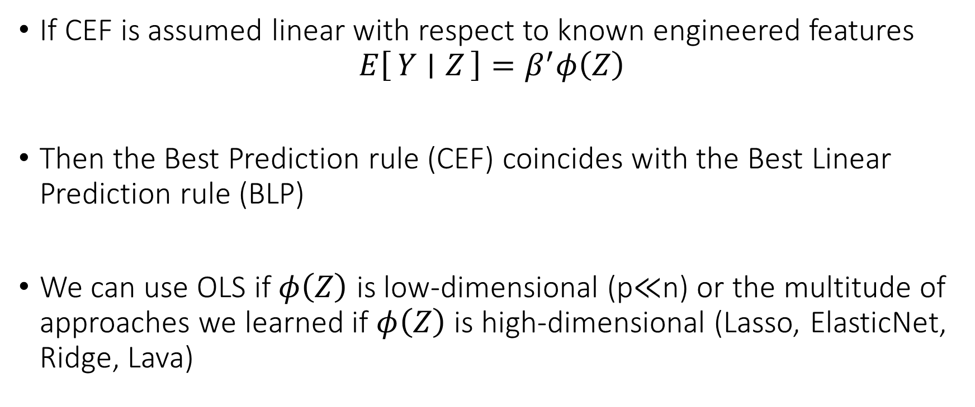
Thus Far: Linear CEF
If CEF is assumed linear with respect to known engineered features
$$E\left[Y ∣ Z\right]=β^{′}φ\left(Z\right)$$
Then the Best Prediction rule (CEF) coincides with the Best Linear Prediction rule (BLP)
We can use OLS if $φ\left(Z\right)$ is low-dimensional (p$≪$n) or the multitude of approaches we learned if $φ\left(Z\right)$ is high-dimensional (Lasso, ElasticNet, Ridge, Lava)

Slide 19
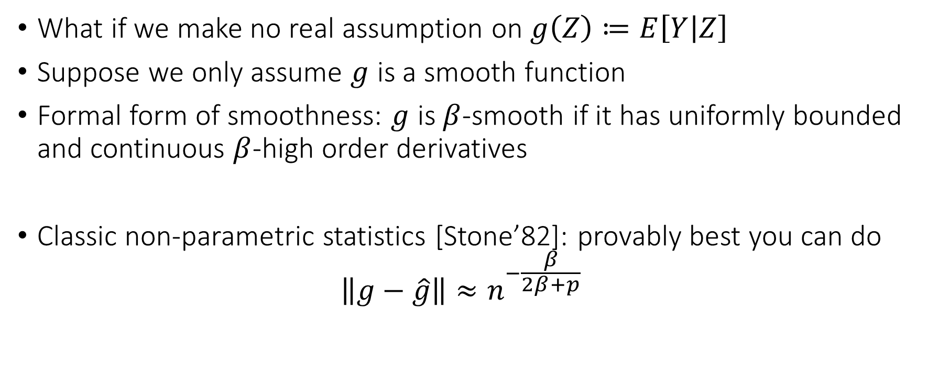
The Curse of Dimensionality
What if we make no real assumption on $g\left(Z\right)≔E\left[Y | Z\right]$
Suppose we only assume $g$ is a smooth function
Formal form of smoothness: $g$ is $β$-smooth if it has uniformly bounded and continuous $β$-high order derivatives
Classic non-parametric statistics [Stone’82]: provably best you can do
$$\left\|g−\hat{g}\right\|≈n^{−\frac{β}{2β+p}}$$

Slide 20
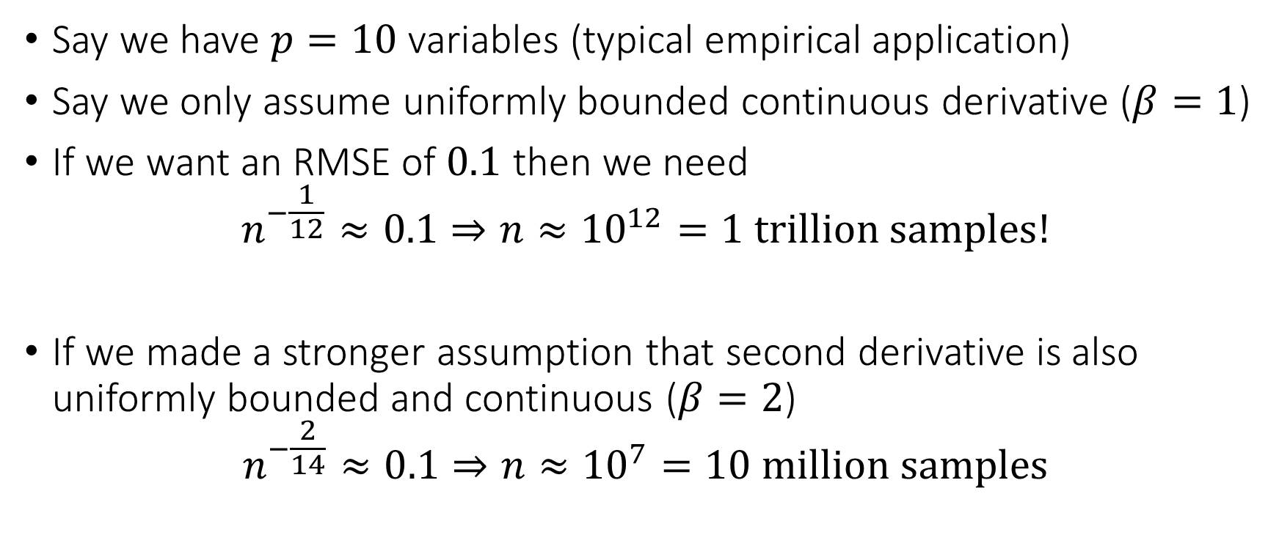
The Curse of Dimensionality
Say we have $p=10$ variables (typical empirical application)
Say we only assume uniformly bounded continuous derivative ($β=1$)
If we want an RMSE of $0.1$ then we need
$$n^{−\frac{1}{12}}≈0.1⇒n≈{10}^{12}=1 trillion samples!$$
If we made a stronger assumption that second derivative is also uniformly bounded and continuous ($β=2$)
$$n^{−\frac{2}{14}}≈0.1⇒n≈{10}^{7}=10 million samples$$

Slide 21
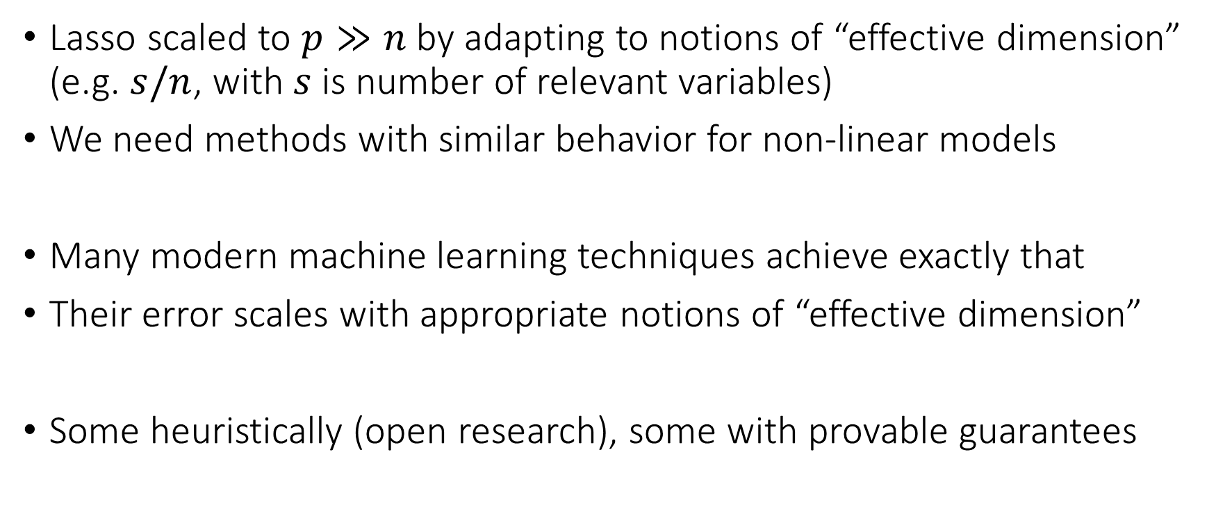
Bypassing the Curse of Dimensionality
Lasso scaled to $p≫n$ by adapting to notions of “effective dimension” (e.g. $s/n$, with $s$ is number of relevant variables)
We need methods with similar behavior for non-linear models
Many modern machine learning techniques achieve exactly that
Their error scales with appropriate notions of “effective dimension”
Some heuristically (open research), some with provable guarantees

Slide 22

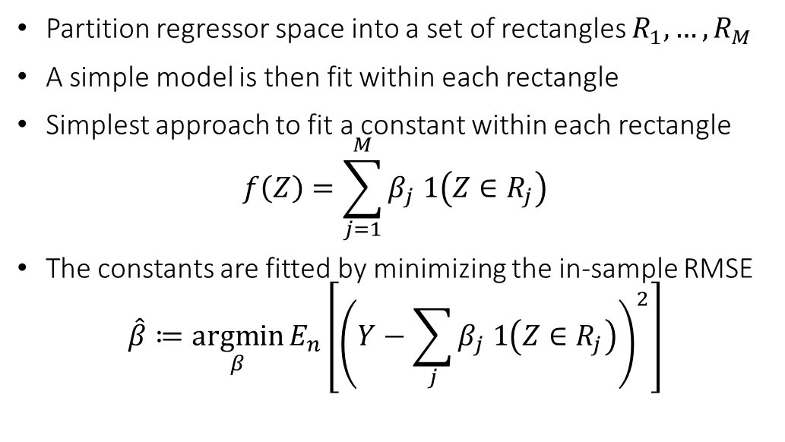
Regression Trees
Partition regressor space into a set of rectangles $R_{1},…, R_{M}$
A simple model is then fit within each rectangle
Simplest approach to fit a constant within each rectangle
$$f\left(Z\right)=\sum_{j=1}^{M}{β_{j} 1\left(Z∈R_{j}\right)}$$
The constants are fitted by minimizing the in-sample RMSE
$$\hat{β}≔\underset{β}{argmin}{E_{n}\left[{\left(Y−\sum_{j}{β_{j} 1\left(Z∈R_{j}\right)}\right)}^{2}\right]}$$

Slide 23
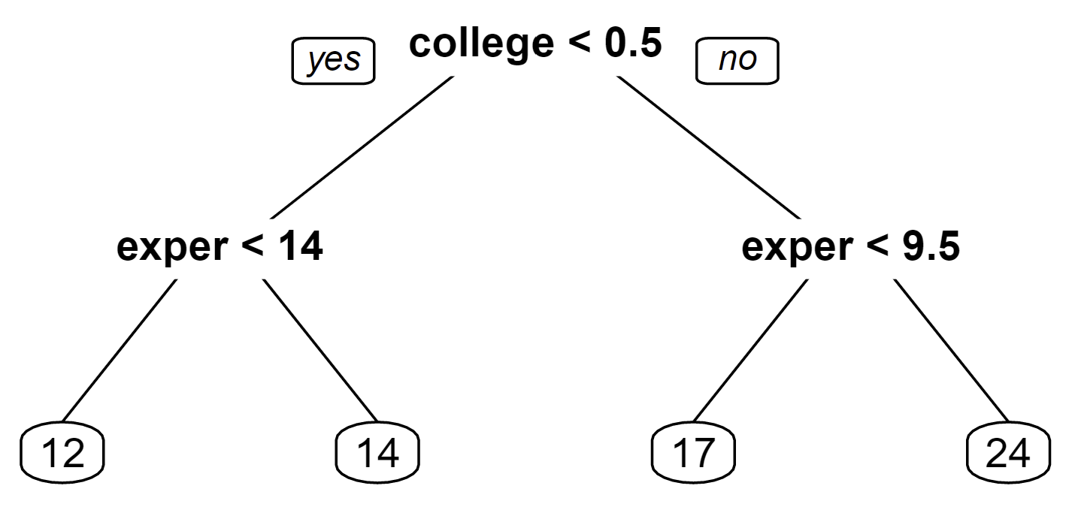
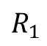
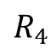
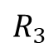
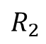
Regression Trees
Rectangles are nicely represented as leafs in a binary decision tree
Key difference with linear models: regions constructed based on the data (otherwise just a simple linear CEF)
$$R_{1}$$
$$R_{2}$$
$$R_{3}$$
$$R_{4}$$

Slide 24
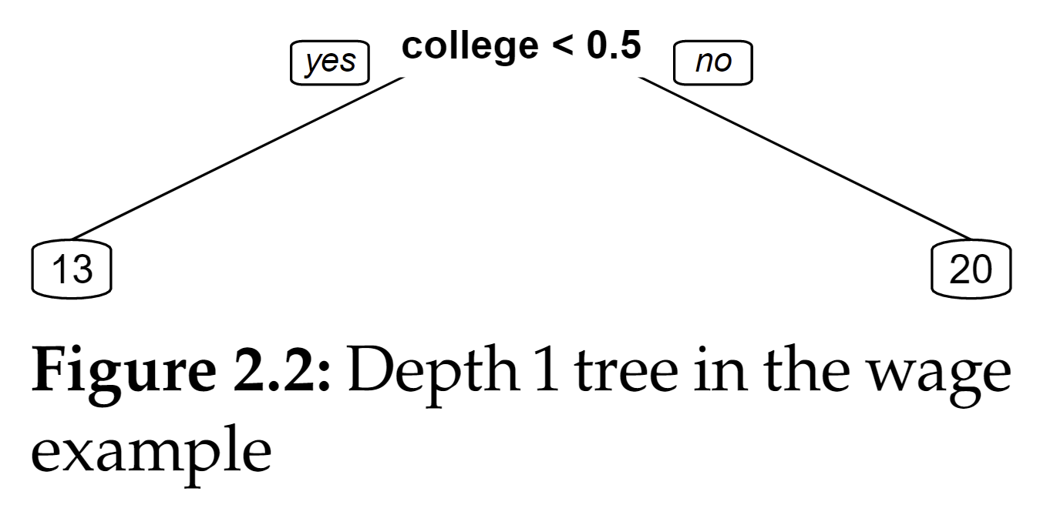
Growing Regression Trees
Regression trees are typically constructed in a “greedy” manner
We start from all the data and find the regressor (e.g. college) and the splitting threshold (e.g. 0.5), that produces largest improvement of in-sample MSE

Slide 25
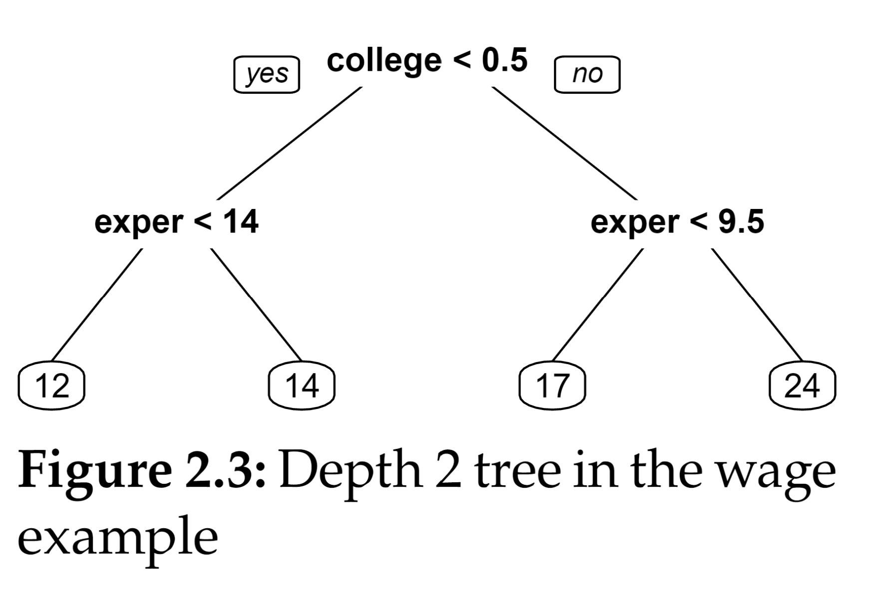
Growing Regression Trees
Regression trees are typically constructed in a “greedy” manner
We then go to each node and locally we find the regressor and threshold on which to split that leads to largest improvement in MSE
We repeat until some stopping criterion (e.g. total number of nodes, minimum number of leaf samples, maximum depth)

Slide 26
Regression Trees: Bias-Variance Tradeoffs
The deeper the tree, the better it can approximate the CEF (small bias)
The deeper the tree, the noisier the estimate is, as we have very few samples in each leaf (higher variance)
Let’s check it out!

Slide 27
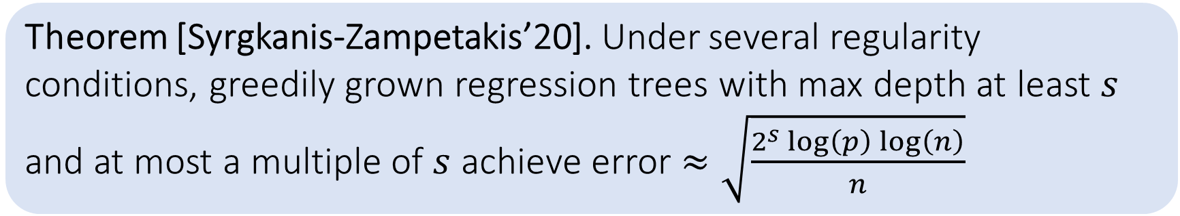
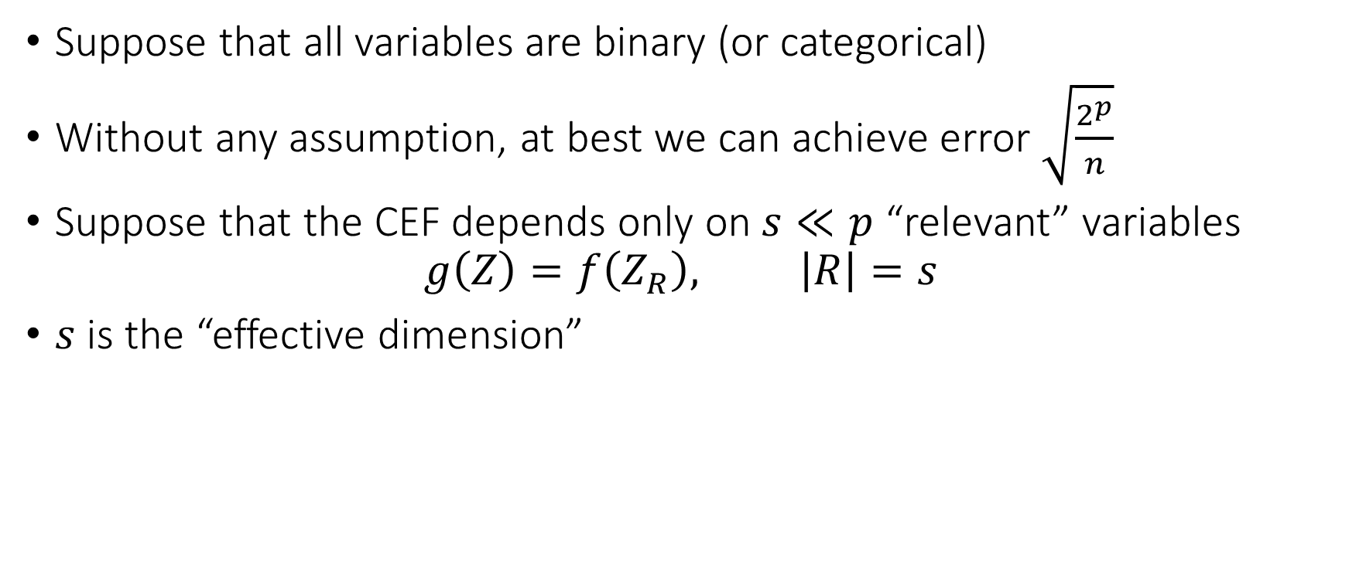
Some Theory
Suppose that all variables are binary (or categorical)
Without any assumption, at best we can achieve error $\sqrt{\frac{2^{p}}{n}}$
Suppose that the CEF depends only on $s≪p$ “relevant” variables
$$g\left(Z\right)=f\left(Z_{R}\right), \left|R\right|=s$$
$s$ is the “effective dimension”
Theorem [Syrgkanis-Zampetakis’20]. Under several regularity conditions, greedily grown regression trees with max depth at least $s$ and at most a multiple of $s$ achieve error $≈\sqrt{\frac{2^{s}\log\left(p\right)\log\left(n\right)}{n}}$

Slide 28
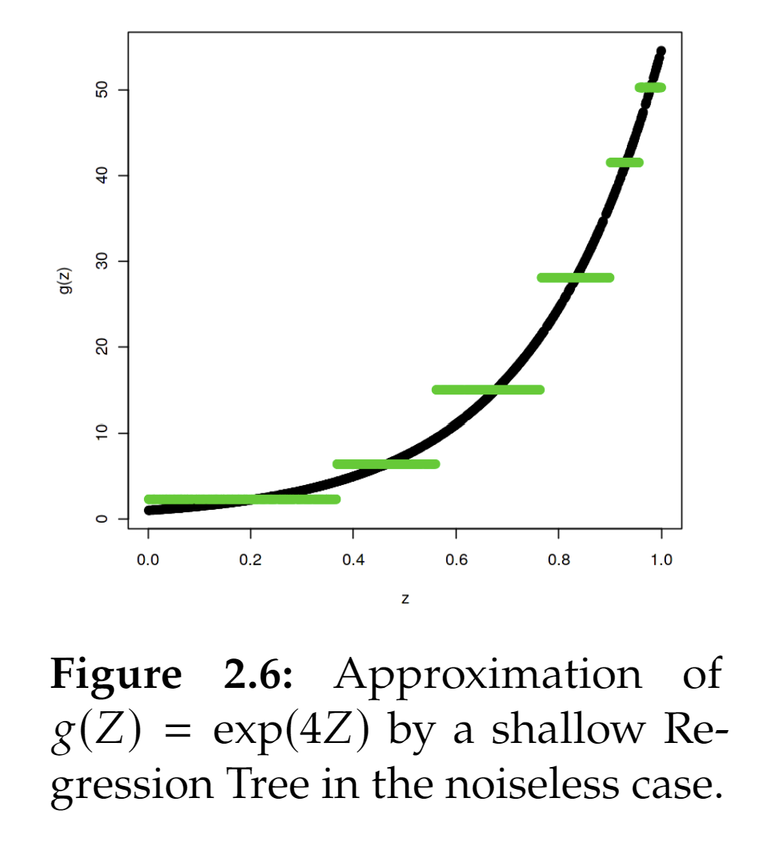
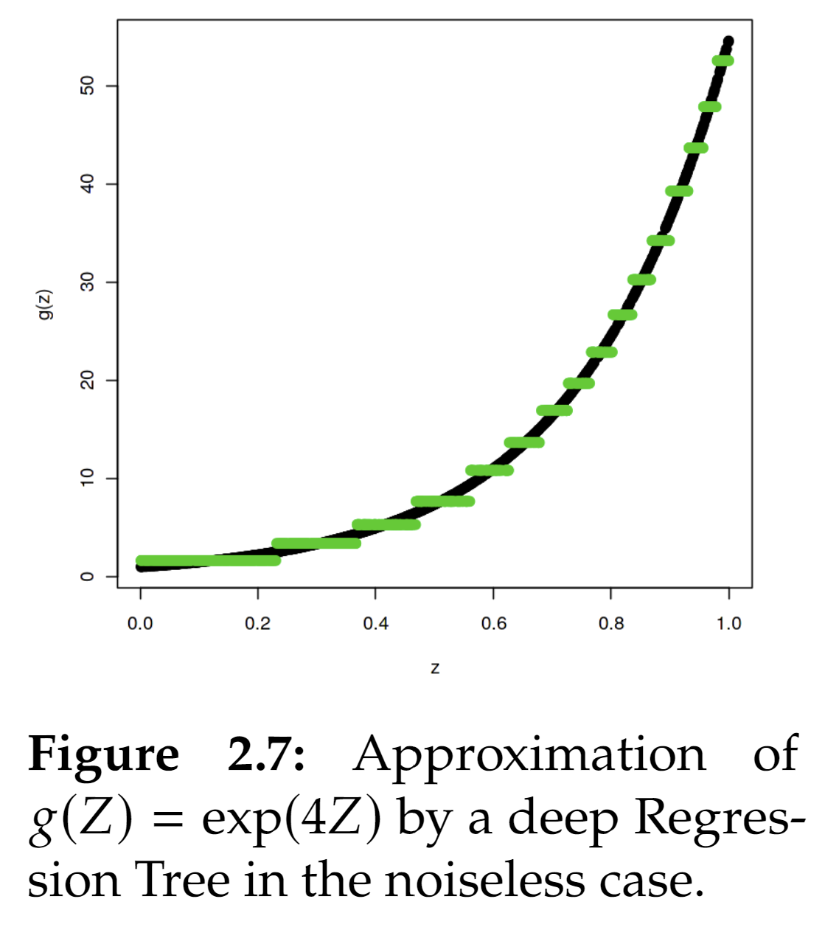
Problems with Trees
They tend to find very discontinuous approximations to the true CEF
Real world CEFs are most times smooth functions
We need to smoothen the output of a regression tree
Basic idea: average over multiple trees, each built by injecting some randomness

Slide 29

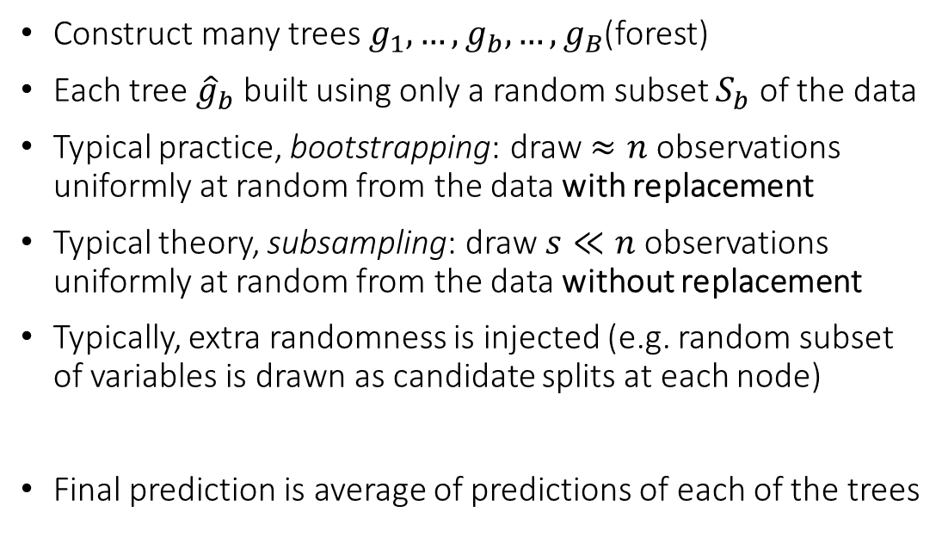
Regression Forests
Construct many trees $g_{1},…,g_{b},…,g_{B}$(forest)
Each tree ${\hat{g}}_{b}$ built using only a random subset $S_{b}$ of the data
Typical practice, bootstrapping: draw $≈n$ observations uniformly at random from the data with replacement
Typical theory, subsampling: draw $s≪n$ observations uniformly at random from the data without replacement
Typically, extra randomness is injected (e.g. random subset of variables is drawn as candidate splits at each node)
Final prediction is average of predictions of each of the trees

Slide 30
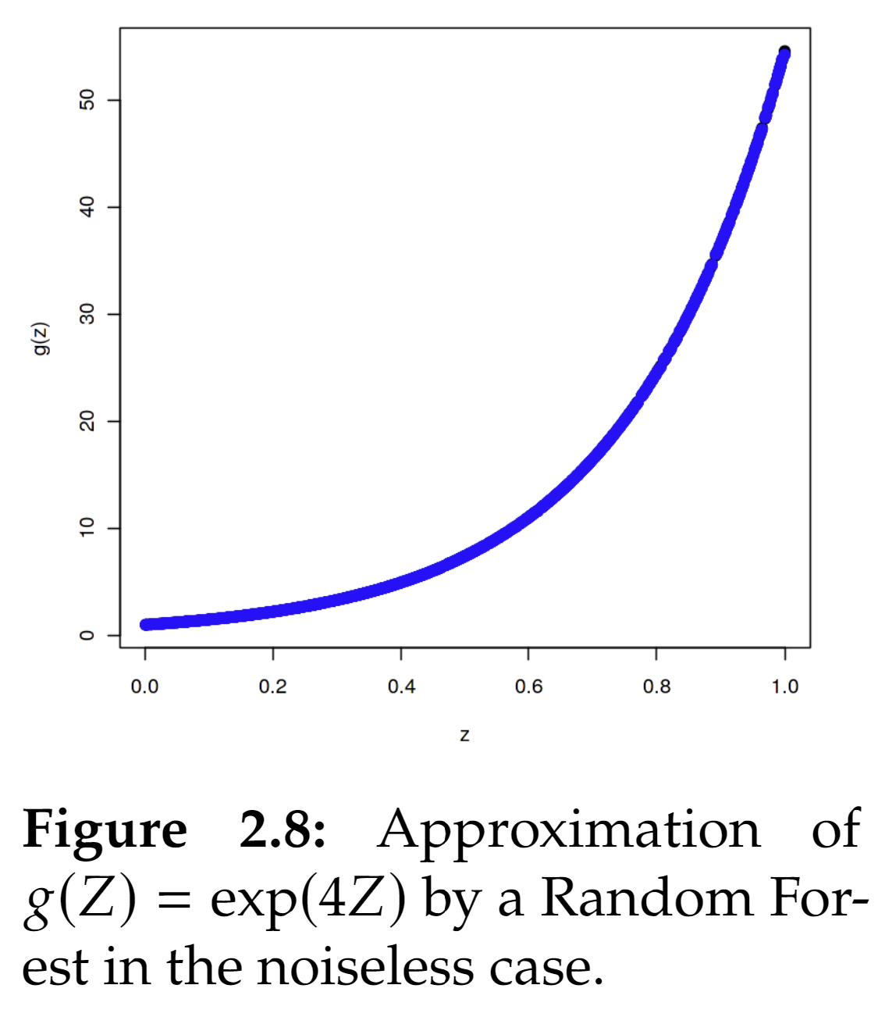
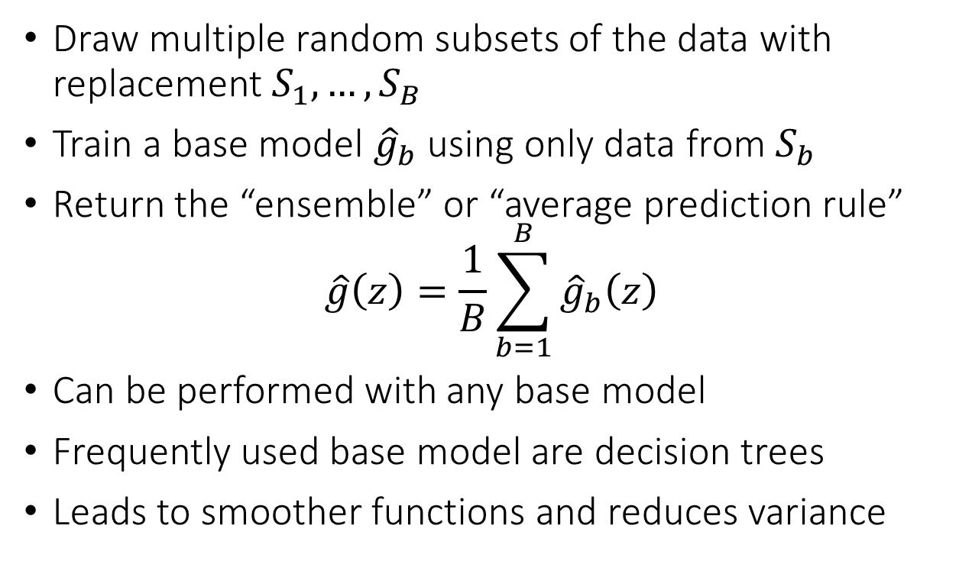
Bagging
Draw multiple random subsets of the data with replacement $S_{1}, …, S_{B}$
Train a base model ${\hat{g}}_{b}$ using only data from $S_{b}$
Return the “ensemble” or “average prediction rule”
$$\hat{g}\left(z\right)=\frac{1}{B}\sum_{b=1}^{B}{{\hat{g}}_{b}\left(z\right)}$$
Can be performed with any base model
Frequently used base model are decision trees
Leads to smoother functions and reduces variance
Let’s check it out!

Slide 31
Other knobs of regularization
Subsampling. typically leads to even better variance reduction, especially for very deep trees
Honesty. construct splits based on half the data and estimate the values at the leaf nodes using the other half; can help a lot in preventing over-fitting
Let’s check it out!

Slide 32
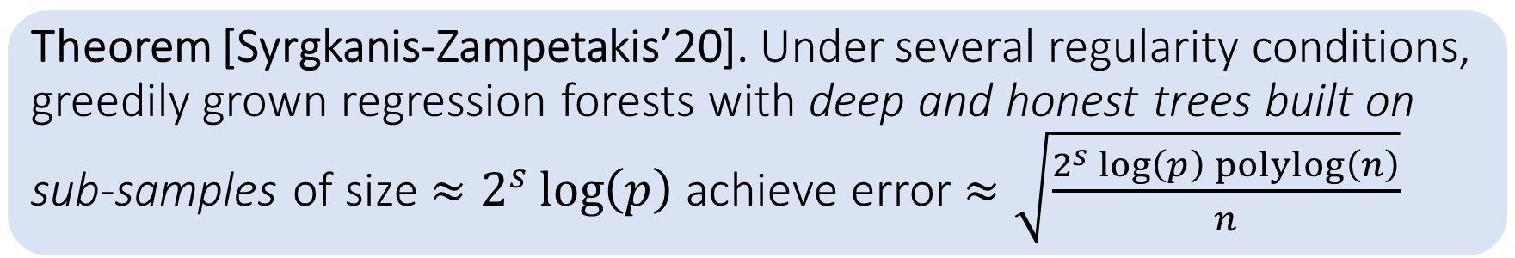
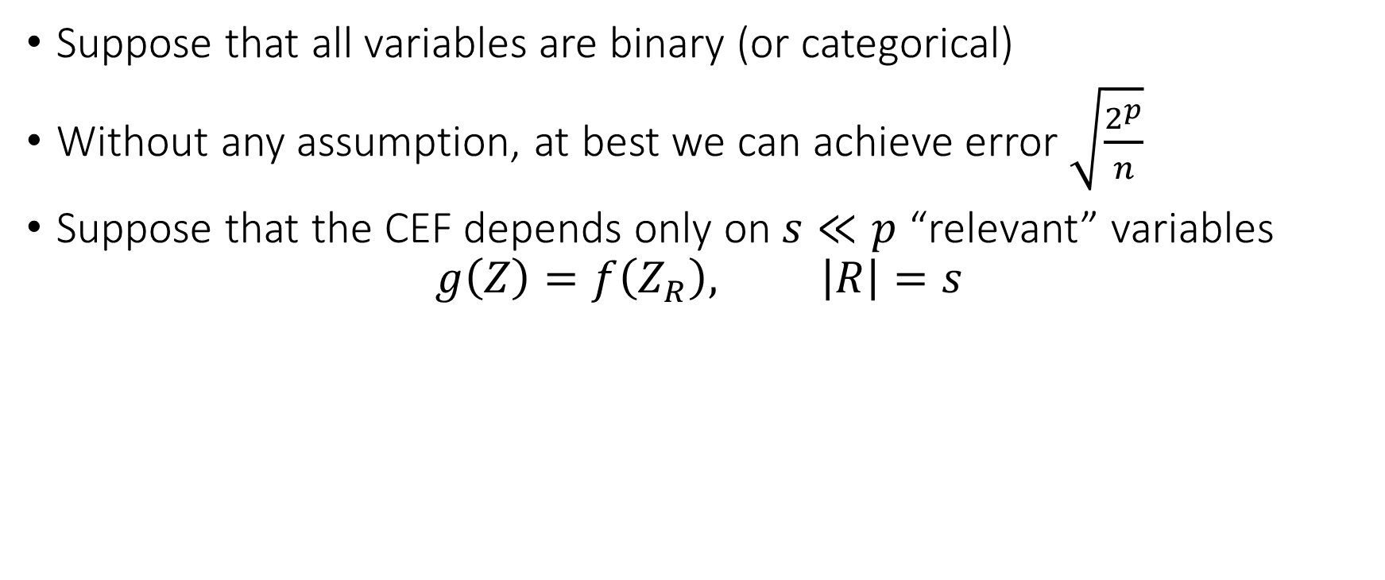
Some Theory
Suppose that all variables are binary (or categorical)
Without any assumption, at best we can achieve error $\sqrt{\frac{2^{p}}{n}}$
Suppose that the CEF depends only on $s≪p$ “relevant” variables
$$g\left(Z\right)=f\left(Z_{R}\right), \left|R\right|=s$$
Theorem [Syrgkanis-Zampetakis’20]. Under several regularity conditions, greedily grown regression forests with deep and honest trees built on sub-samples of size $≈2^{s}\log\left(p\right)$ achieve error $≈\sqrt{\frac{2^{s}\log\left(p\right)\operatorname{polylog}\left(n\right)}{n}}$

Slide 33
Problems with Bagging
The different base models are trained without “knowledge” of what the other models learned
Maybe we want to build base models incrementally
Every time we try to capture some variation/pattern in the outcome that has not been captured so far
This is the idea of Gradient Boosting!

Slide 34
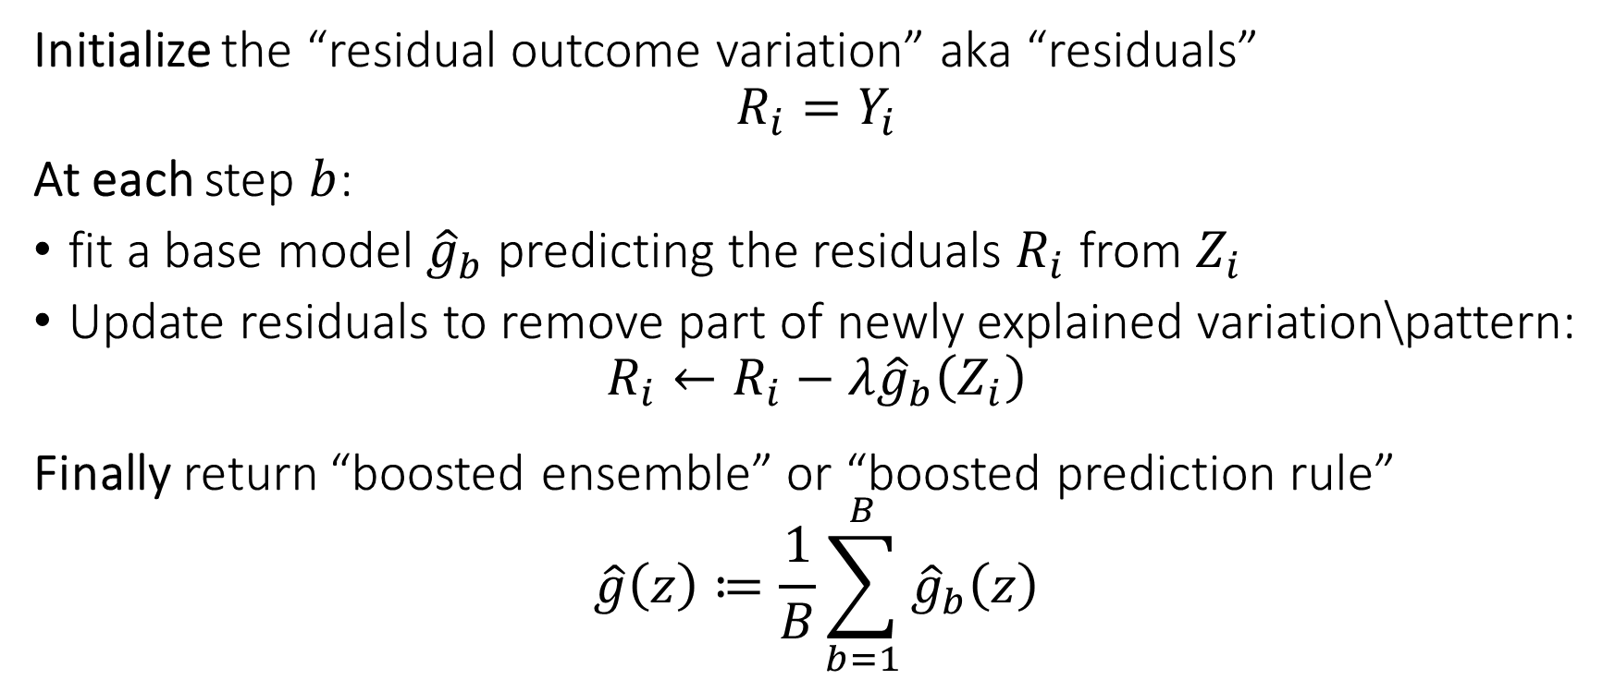
Gradient Boosting
Initialize the “residual outcome variation” aka “residuals”
$$R_{i}=Y_{i}$$
At each step $b$:
fit a base model ${\hat{g}}_{b}$ predicting the residuals $R_{i}$ from $Z_{i}$
Update residuals to remove part of newly explained variation\pattern:
$$R_{i}←R_{i}−λ{\hat{g}}_{b}\left(Z_{i}\right)$$
Finally return “boosted ensemble” or “boosted prediction rule”
$$\hat{g}\left(z\right)≔\frac{1}{B}\sum_{b=1}^{B}{{\hat{g}}_{b}\left(z\right)}$$

Slide 35
Gradient Boosted Forests
Gradient boosting can be applied with any base model
Frequently used base model are simple decision trees
Takes simple functions and “boosts” their approximation capabilities
Unlike bagging: typically leads to smaller bias but higher variance
Best way to control variance increase is to perform “early stopping”
At each step measure performance of current ensemble on a validation set
Stop when you see that validation set performance increases
Let’s check it out!

Slide 36
Gradient Boosted Forests
Theory less well developed in high-dimensions
Some very nice theoretical results proving consistency and adaptivity to notions of statistical complexity; early stopping is crucial
Some pointers
Beygelzimer, Alina, et al. "Online gradient boosting." Advances in neural information processing systems 28 (2015).
Zhang, Tong, and Bin Yu. "Boosting with early stopping: Convergence and consistency." (2005): 1538-1579.
Wei, Yuting, Fanny Yang, and Martin J. Wainwright. "Early stopping for kernel boosting algorithms: A general analysis with localized complexities." Advances in Neural Information Processing Systems 30 (2017).

Slide 37
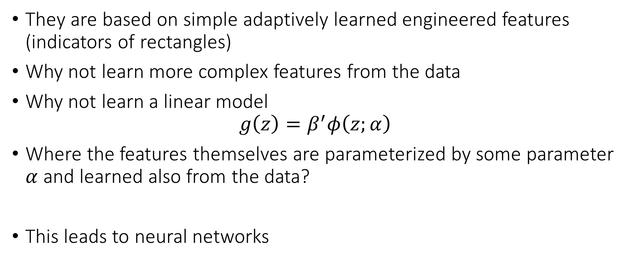
Problems with Forests and Trees
They are based on simple adaptively learned engineered features (indicators of rectangles)
Why not learn more complex features from the data
Why not learn a linear model
$$g\left(z\right)=β^{′}φ\left(z;α\right)$$
Where the features themselves are parameterized by some parameter $α$ and learned also from the data?
This leads to neural networks

Slide 38
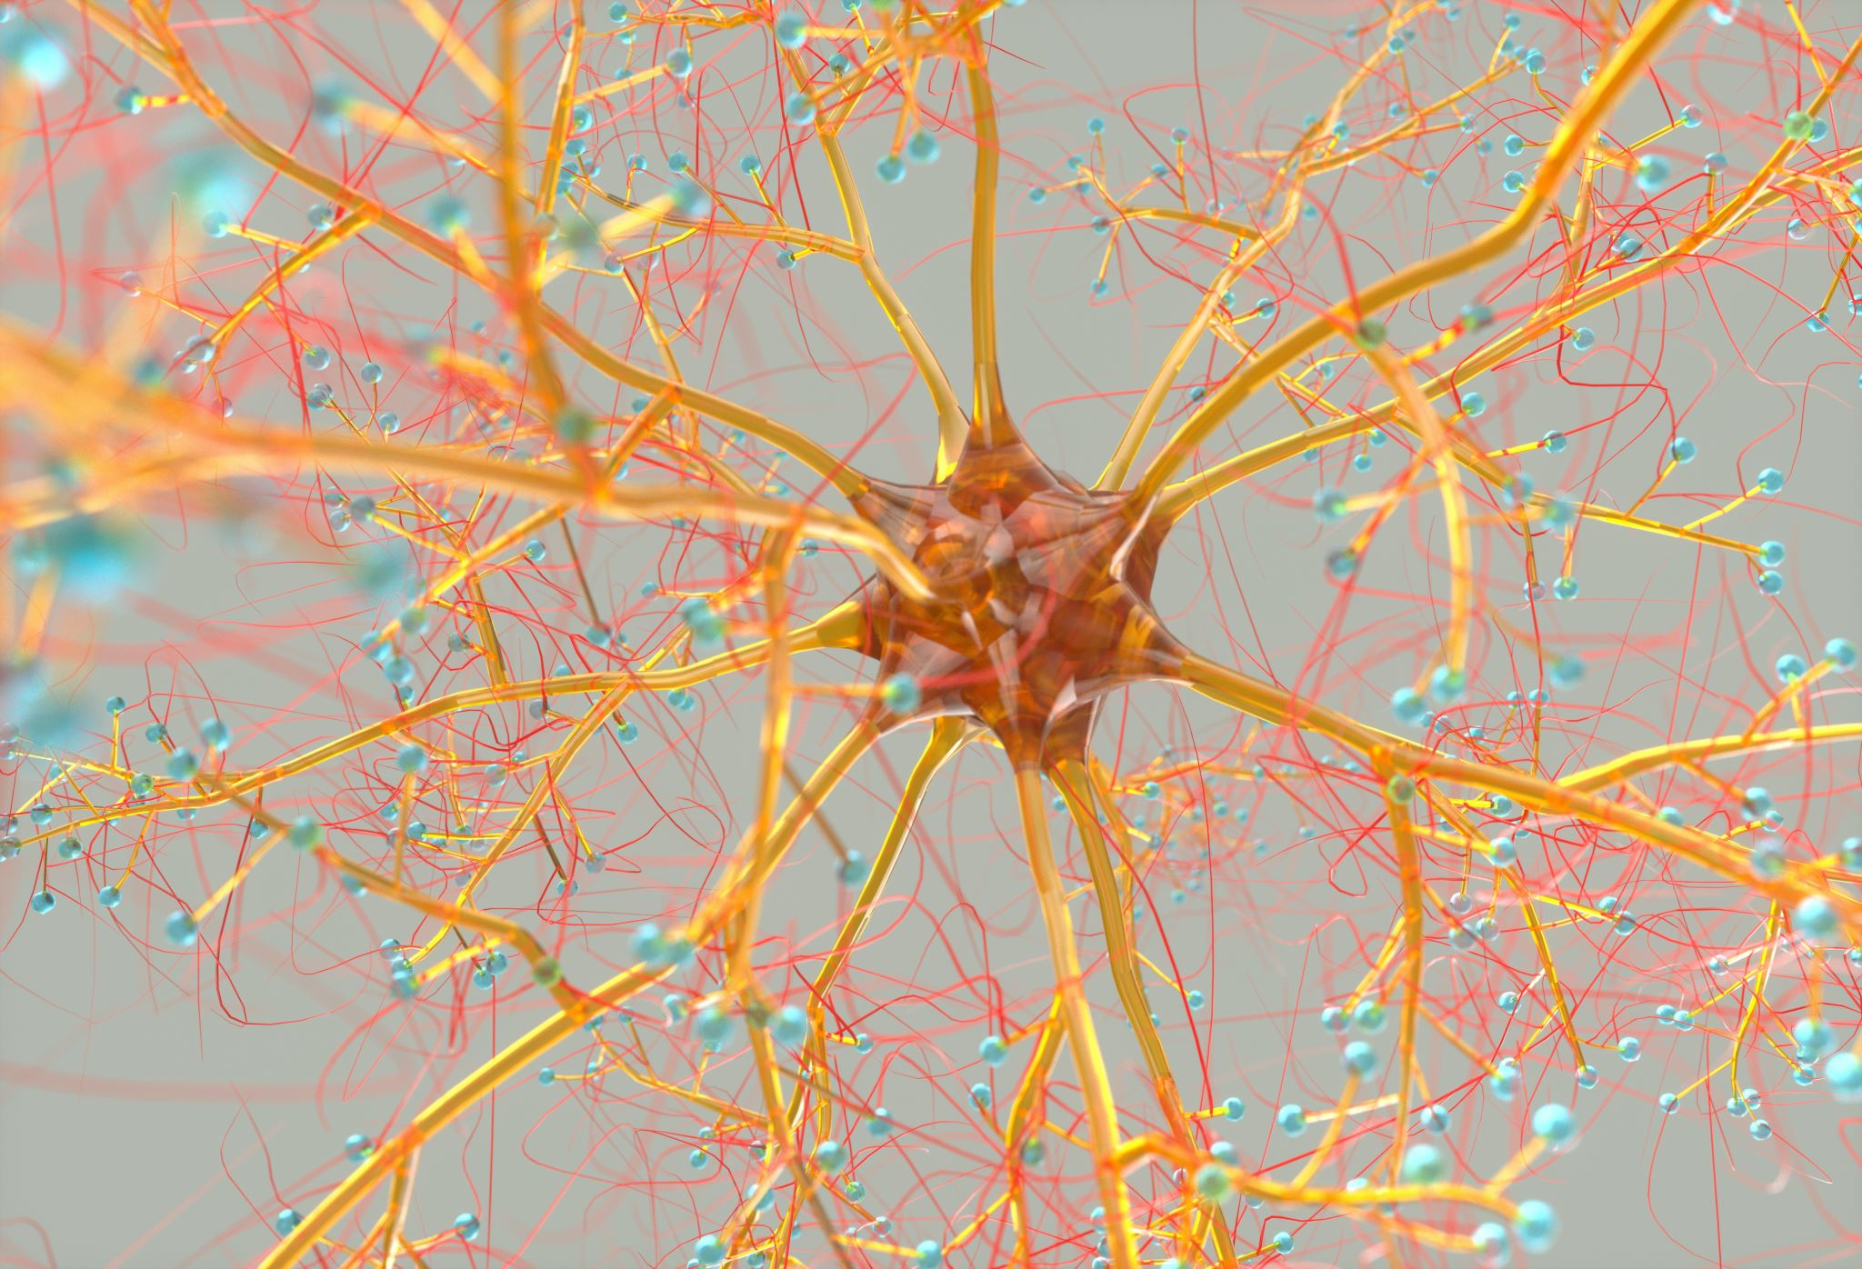
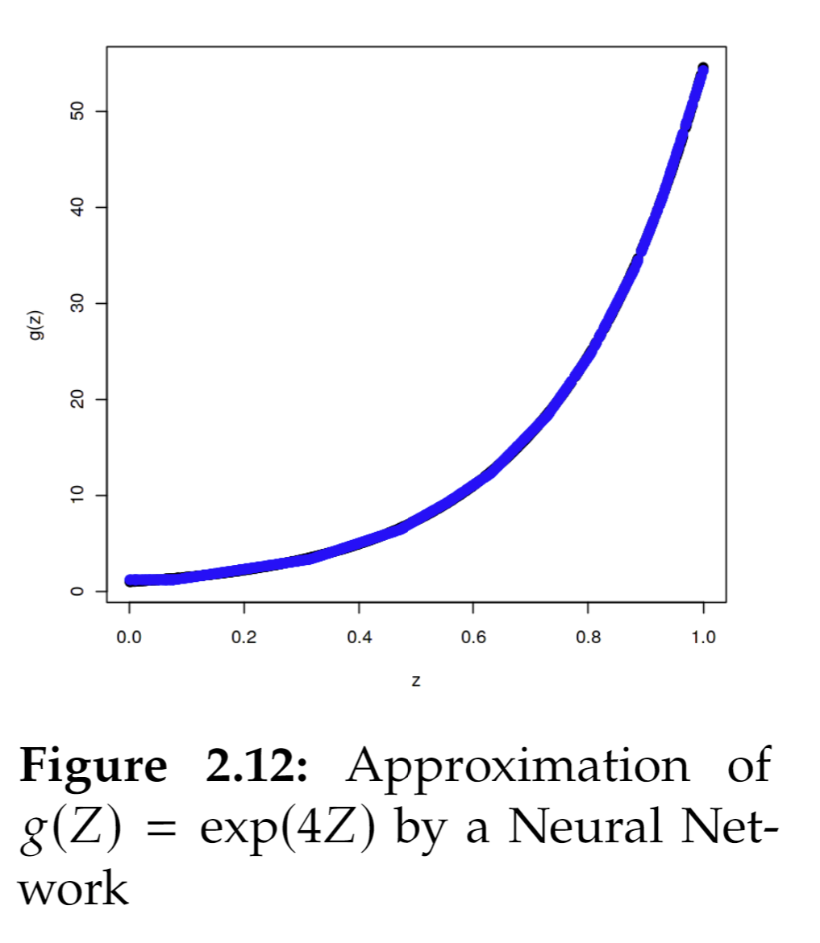
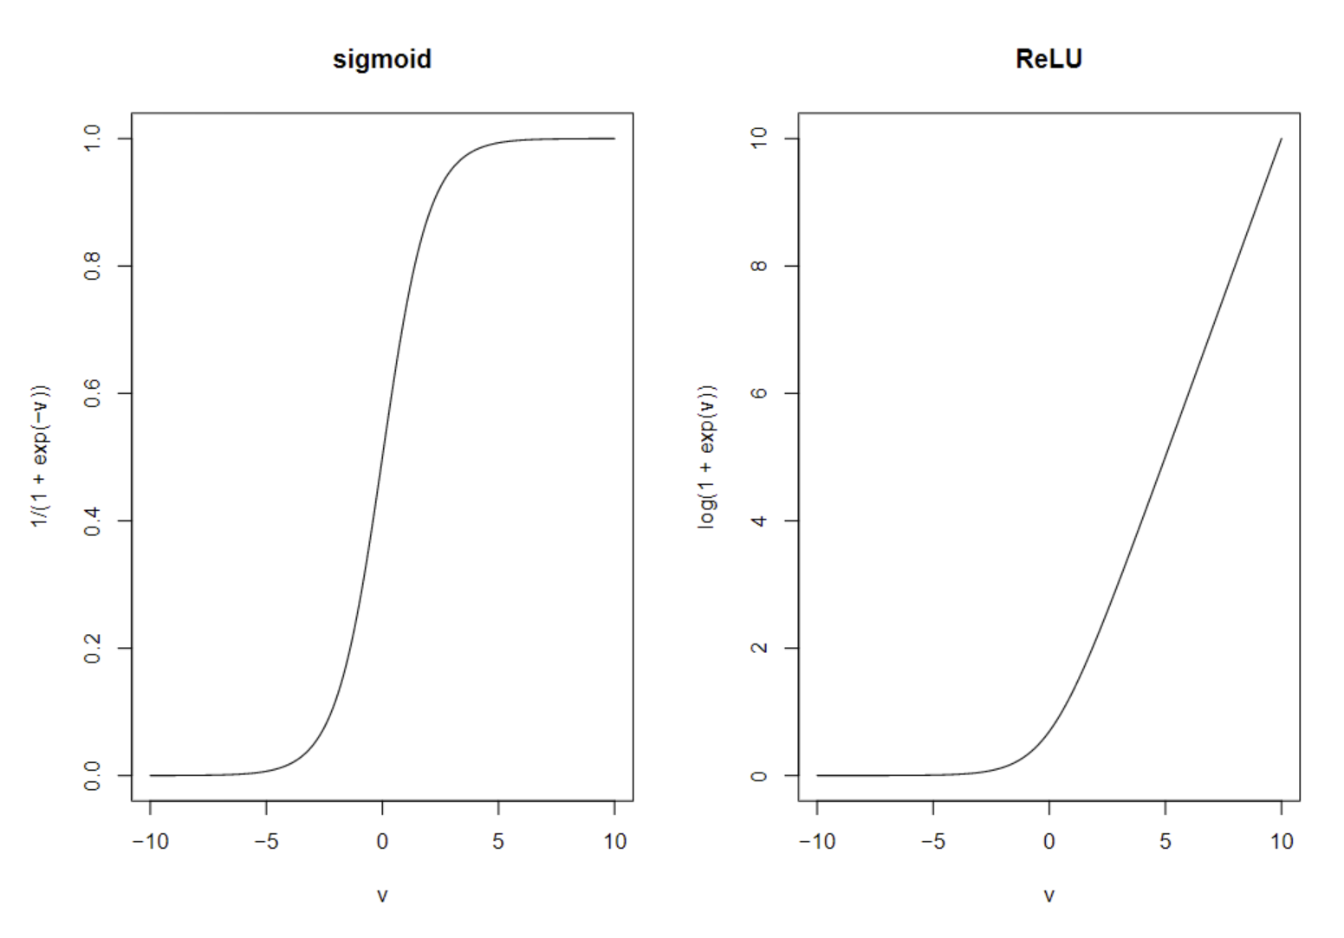
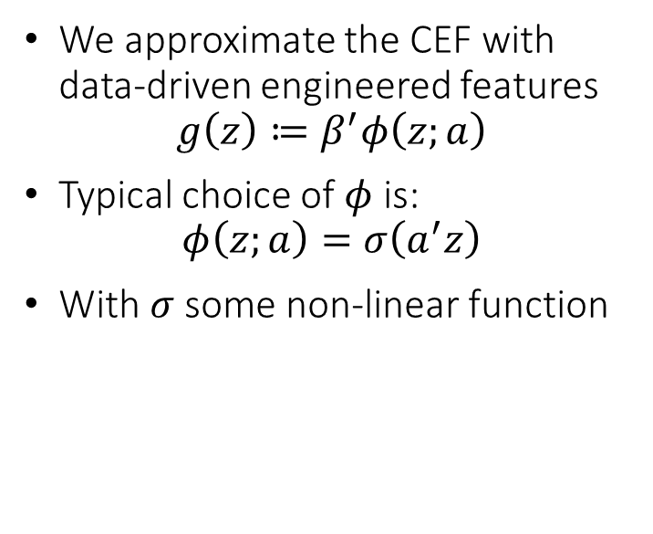
(Shallow) Neural Networks
We approximate the CEF with data-driven engineered features
$$g\left(z\right)≔β^{′}φ\left(z;a\right)$$
Typical choice of $φ$ is:
$$φ\left(z;a\right)=σ\left(a^{′}z\right)$$
With $σ$ some non-linear function

Slide 39
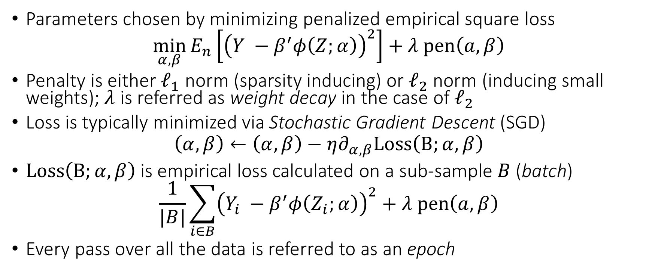
(Shallow) Neural Network Objective
Parameters chosen by minimizing penalized empirical square loss
$$\min_{α,β}{E_{n}\left[{\left(Y −β^{′}φ\left(Z;α\right)\right)}^{2}\right]+λ pen\left(a,β\right)}$$
Penalty is either $ℓ_{1}$ norm (sparsity inducing) or $ℓ_{2}$ norm (inducing small weights); $λ$ is referred as weight decay in the case of $ℓ_{2}$
Loss is typically minimized via Stochastic Gradient Descent (SGD)
$$\left(α,β\right)←\left(α,β\right)−η∂_{α,β}Loss\left(B;α,β\right)$$
$Loss\left(B;α,β\right)$ is empirical loss calculated on a sub-sample $B$ (batch)
$$\frac{1}{|B|}\sum_{i∈B}{{\left(Y_{i} −β^{′}φ\left(Z_{i};α\right)\right)}^{2}}+λ pen\left(a,β\right)$$
Every pass over all the data is referred to as an epoch

Slide 40
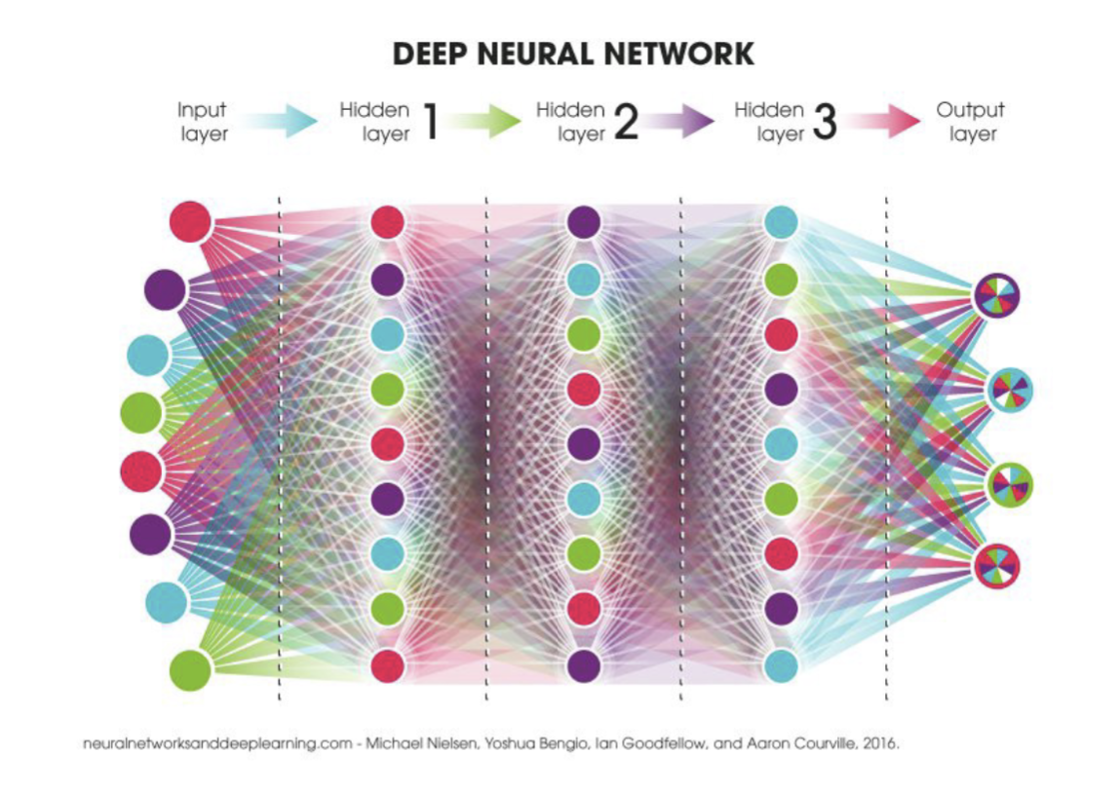

Slide 41
Forms of Regularization
Stochasticity and iterative nature of SGD is by itself a regularization method (implicit regularization)
Penalties are explicit form of regularization
Drop-out. At each training step, shutdown some of the neurons. Implicitly regularizes by having multiple neurons learn important concepts, acting as substitutes
Early stopping. Measure out of sample performance after a few iterations of SGD and stop if it stops improving
Let’s check it out!

Slide 42
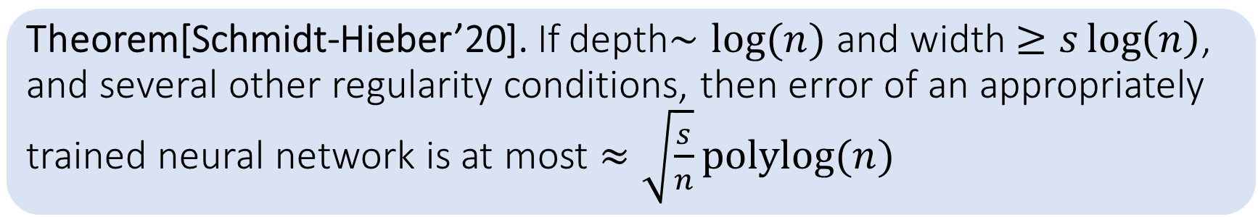
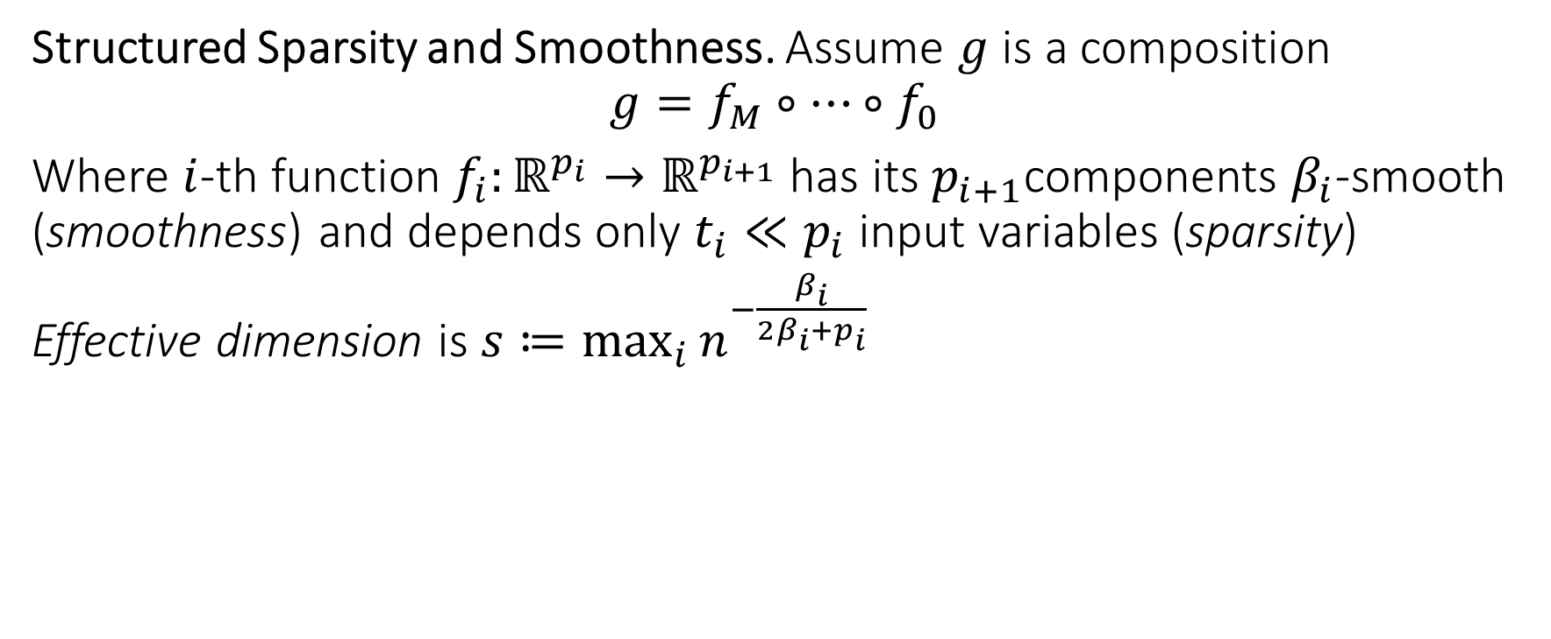
Some Theory
Structured Sparsity and Smoothness. Assume $g$ is a composition
$$g=f_{M}∘…∘f_{0}$$
Where $i$-th function $f_{i}:ℝ^{p_{i}}→ℝ^{p_{i+1}}$ has its $p_{i+1}$components $β_{i}$-smooth (smoothness) and depends only $t_{i}≪p_{i}$ input variables (sparsity)
Effective dimension is $s≔\max_{i}{n^{−\frac{β_{i}}{2β_{i}+p_{i}}}}$
Theorem[Schmidt-Hieber’20]. If depth$∼log⁡(n)$ and width $≥s\log\left(n\right)$, and several other regularity conditions, then error of an appropriately trained neural network is at most $≈\sqrt{\frac{s}{n}}polylog(n)$

Slide 43
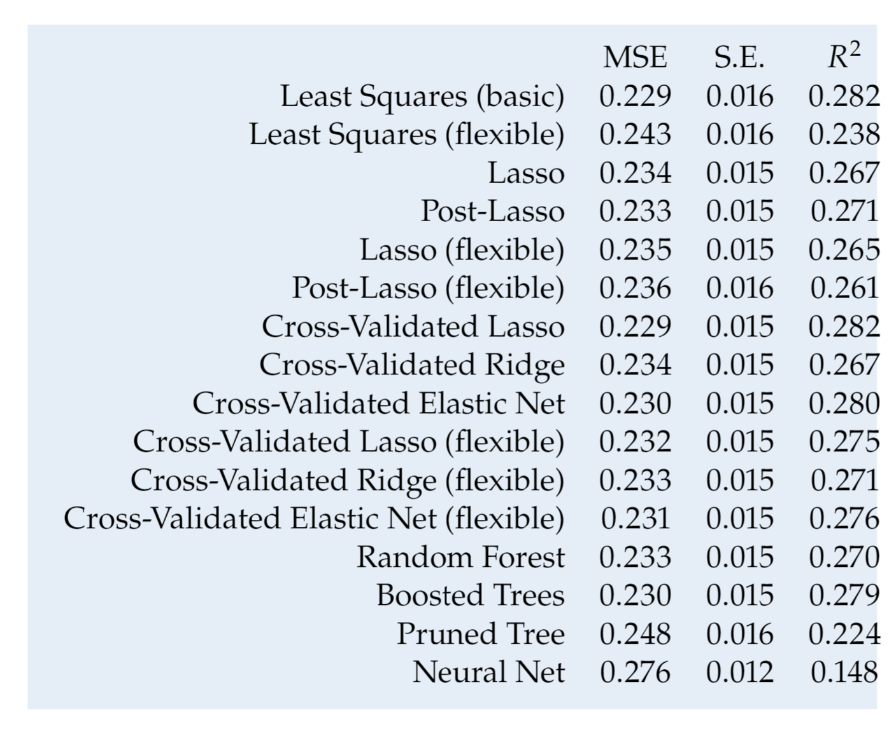
A Reminder: Fancy isn’t always better
Predictive performance for predicting wages

Slide 44
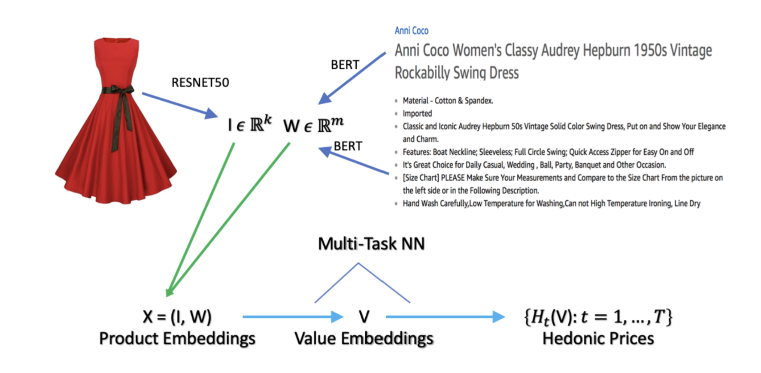
But many times it is crucial
Predicting prices from product characteristics at Amazon
Bajari et al. 2021, Hedonic prices and quality adjusted price indices powered by AI.

Slide 45
Which method should I use?

Slide 46
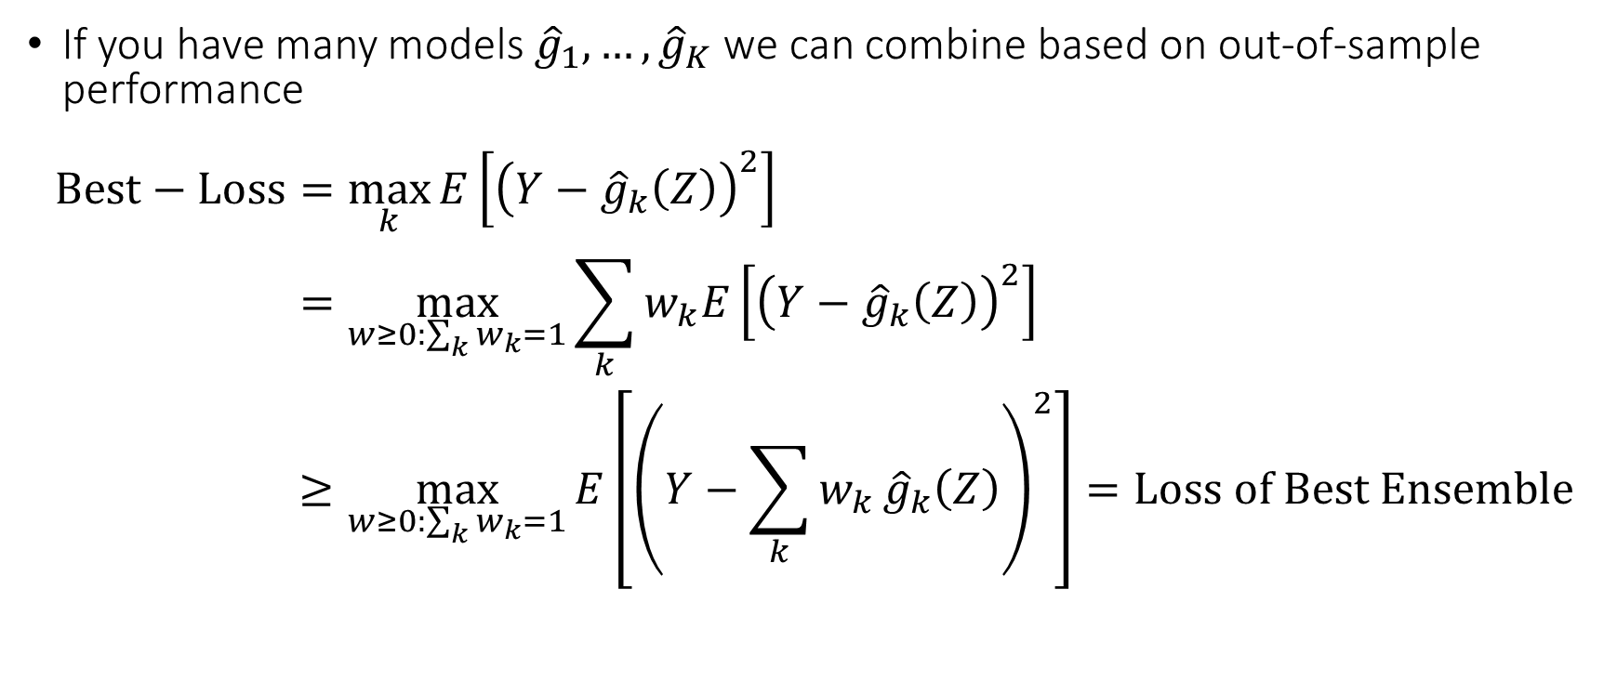
Use all and combine: Stacking
If you have many models ${\hat{g}}_{1},…,{\hat{g}}_{K}$ we can combine based on out-of-sample performance
$$\begin{aligned}Best−Loss=&\max_{k}{E\left[{\left(Y−{\hat{g}}_{k}\left(Z\right)\right)}^{2}\right]} \\ =&\max_{w≥0:\sum_{k}{w_{k}}=1}{\sum_{k}{w_{k}E\left[{\left(Y−{\hat{g}}_{k}\left(Z\right)\right)}^{2}\right]}} \\ ≥&\max_{w≥0:\sum_{k}{w_{k}}=1}{E\left[{\left(Y−\sum_{k}{w_{k}}{\hat{g}}_{k}\left(Z\right)\right)}^{2}\right]}=Loss of Best Ensemble\end{aligned}$$

Slide 47
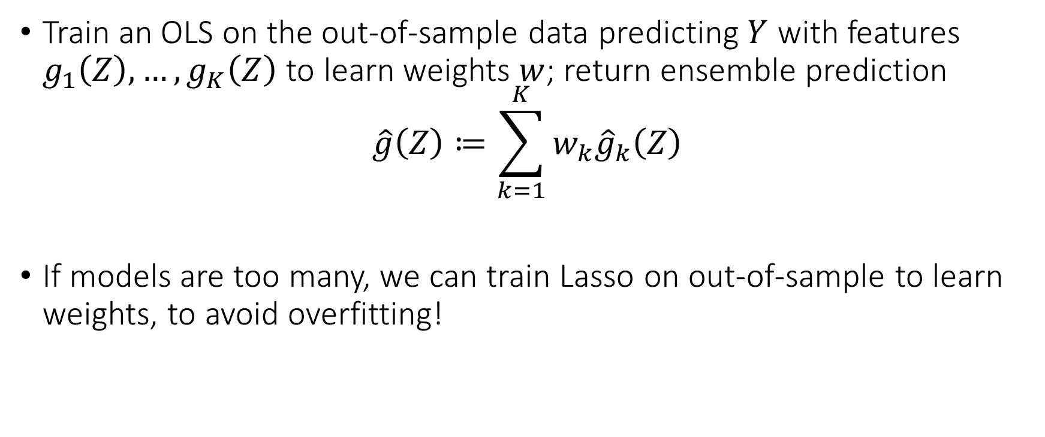
Stacking
Train an OLS on the out-of-sample data predicting $Y$ with features $g_{1}\left(Z\right),…,g_{K}\left(Z\right)$ to learn weights $w$; return ensemble prediction
$$\hat{g}\left(Z\right)≔\sum_{k=1}^{K}{w_{k}{\hat{g}}_{k}\left(Z\right)}$$
If models are too many, we can train Lasso on out-of-sample to learn weights, to avoid overfitting!
Let’s check it out!

Slide 48
How do I choose all these hyperparameters?

Slide 49
Use Auto-ML frameworks!
Automatic and clever search over the hyperparameter space
Very few lines of code
Typically much better performance than handpicking yourself
Unless a lot of domain knowledge of what types of functions are better approximators
Many user-friendly tools: H2O-AutoML, Auto-Gluon, Azure-AutoML, FLAML, Auto-Sklearn, HyperOpt-Sklearn

